Slide 1
Multivariate Modeling DATS 6450 Instructor: Dr. Reza Jafari Term Project Changhao Ying 04/15 /2020

Slide 2
Data
Apple stock price from 2006 to 2017
Raw Source: https://www.kaggle.com/szrlee/stock time series
5 variables: High, Low, Open, Close, Volume

Slide 3
Preprocess of the data
3019 samples

Slide 4
Preprocess of the data

Slide 5


Slide 6
The p value is 0.99 which is higher than 0.05 that means the dependent variable is not stationary.

Slide 7
The p value o f the ADF test after first difference is less than 0.05 so now it is stationary.

Slide 10

Divide volume 1000000 as the unit will be million.
Delete 0 and negative values in the dependent variable
1563 samples finally, split the dataset

Slide 11

Time series decomposition

Slide 12

Multiplicative

Slide 13
Holt Winter

Slide 14

The Q value is high which means the residual is not autocorrelated. The mean, variance, MSE and RMSE is low which means the model is not biased.

Slide 15
Linear Regression

Slide 16


Slide 18
ARMA
ARMA(1,1)
ARMA(2,1)

Slide 19
ARMA(1,1)

Slide 20
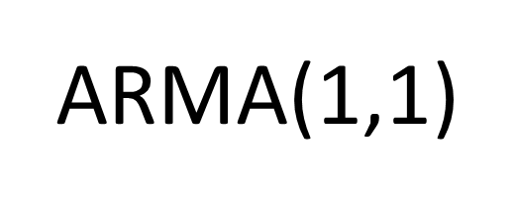

Slide 23
ARMA(2,1)

Slide 24
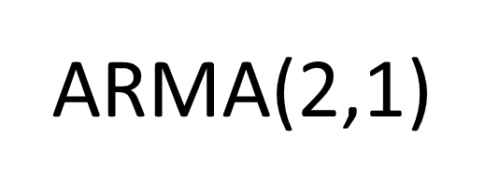

Slide 27
Final Model Selection

Slide 28
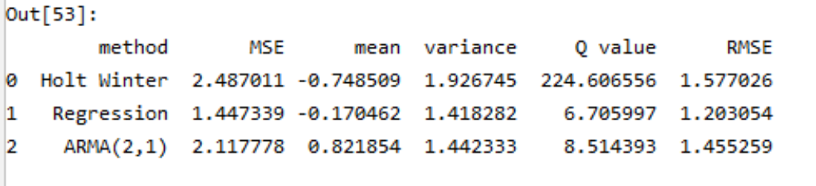
Final Model Selection
Q value of Holt Winter is high
Outliers acceptable

Slide 29
Summary and Limitation
Disadvantage:
R squared is low
Independent variables are not enough
Advantage:
Model is not biased
Suggestion:
Try more ARMA model

Slide 30
Question?

